Slide 1

Optimization Algorithms
Understanding
mini-batch
gradient descent
deeplearning.ai

Slide 2
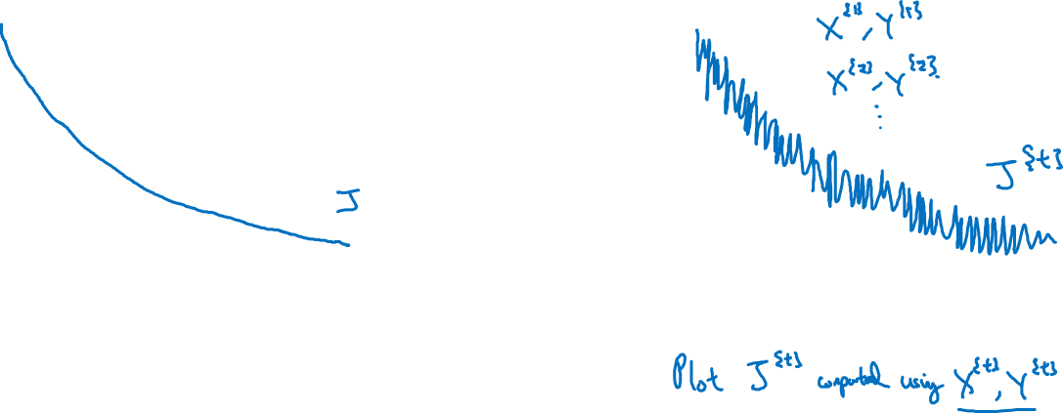
Training with mini batch gradient descent
Batch gradient descent
Mini-batch gradient descent
cost
cost
# iterations
mini batch # (t)

Slide 3
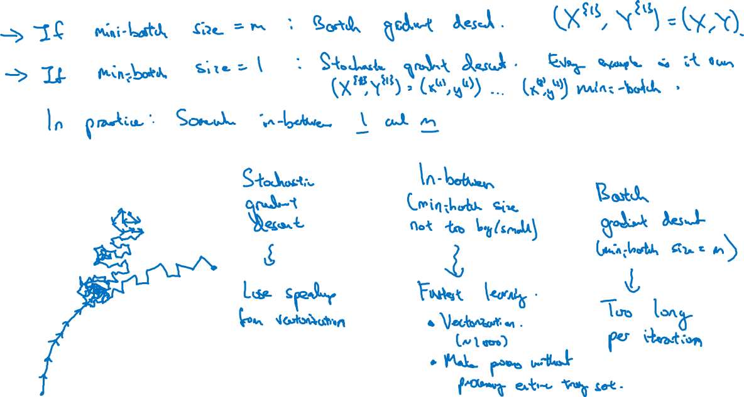
Choosing your mini-batch size

Slide 4
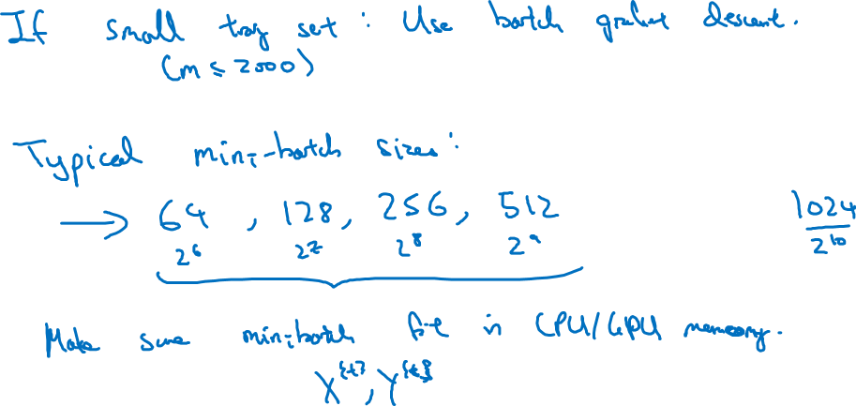
Choosing your mini-batch size

